Slide 1
Final Review 1 2015 exam questions
2019-12-03
Yaping Zheng
PhD in Accounting, McGill University
yaping.zheng@mail.mcgill.ca

Slide 2
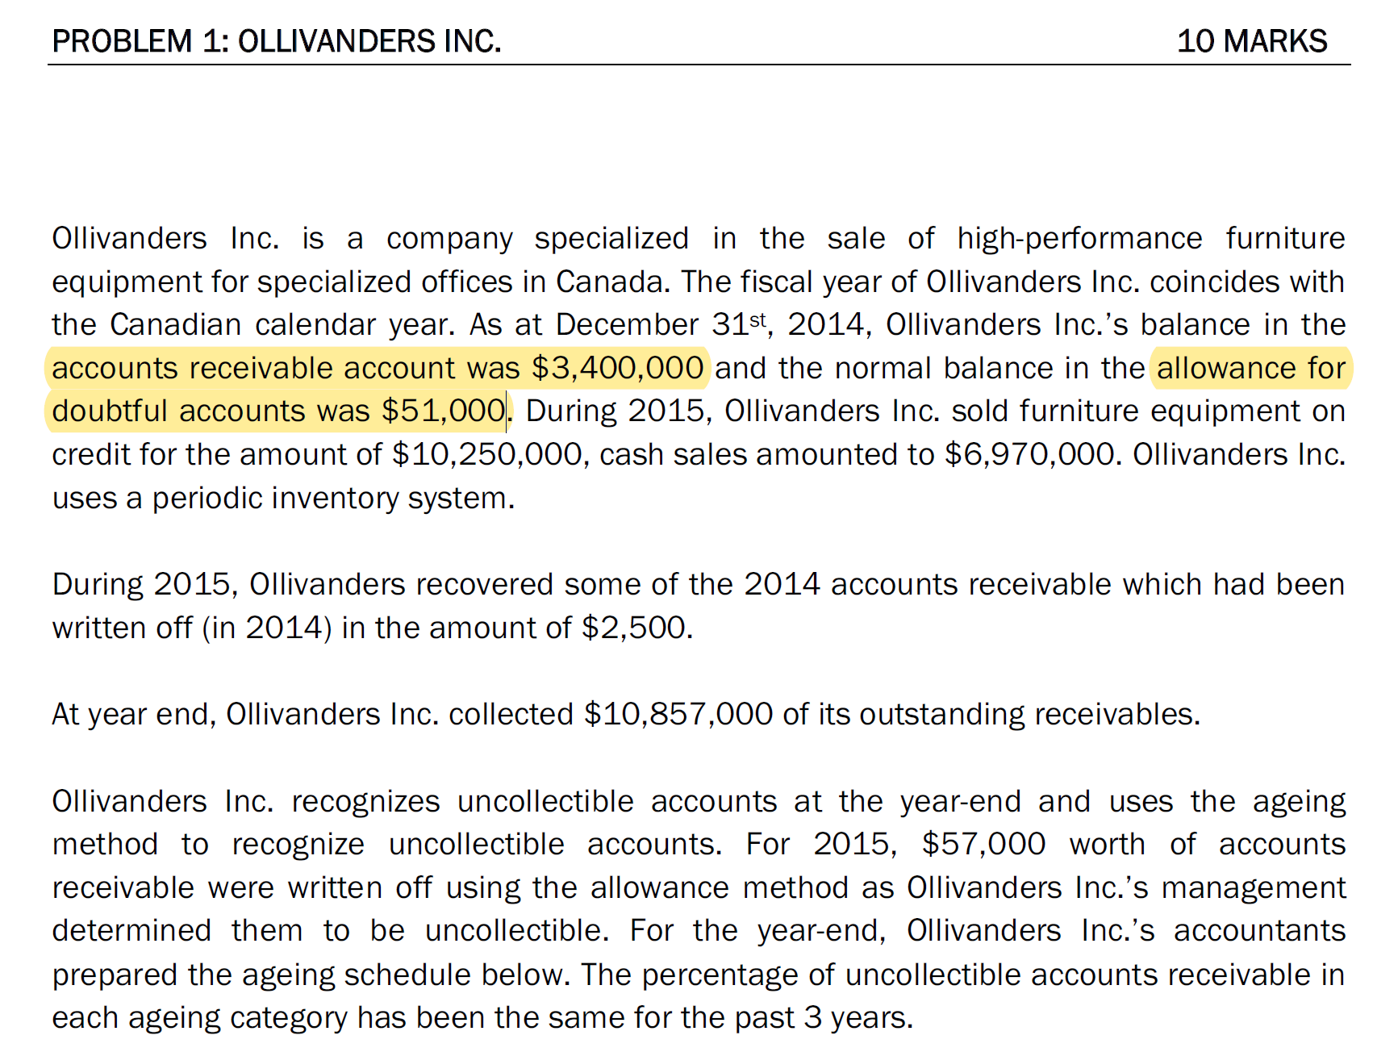
401120
401120

Slide 3
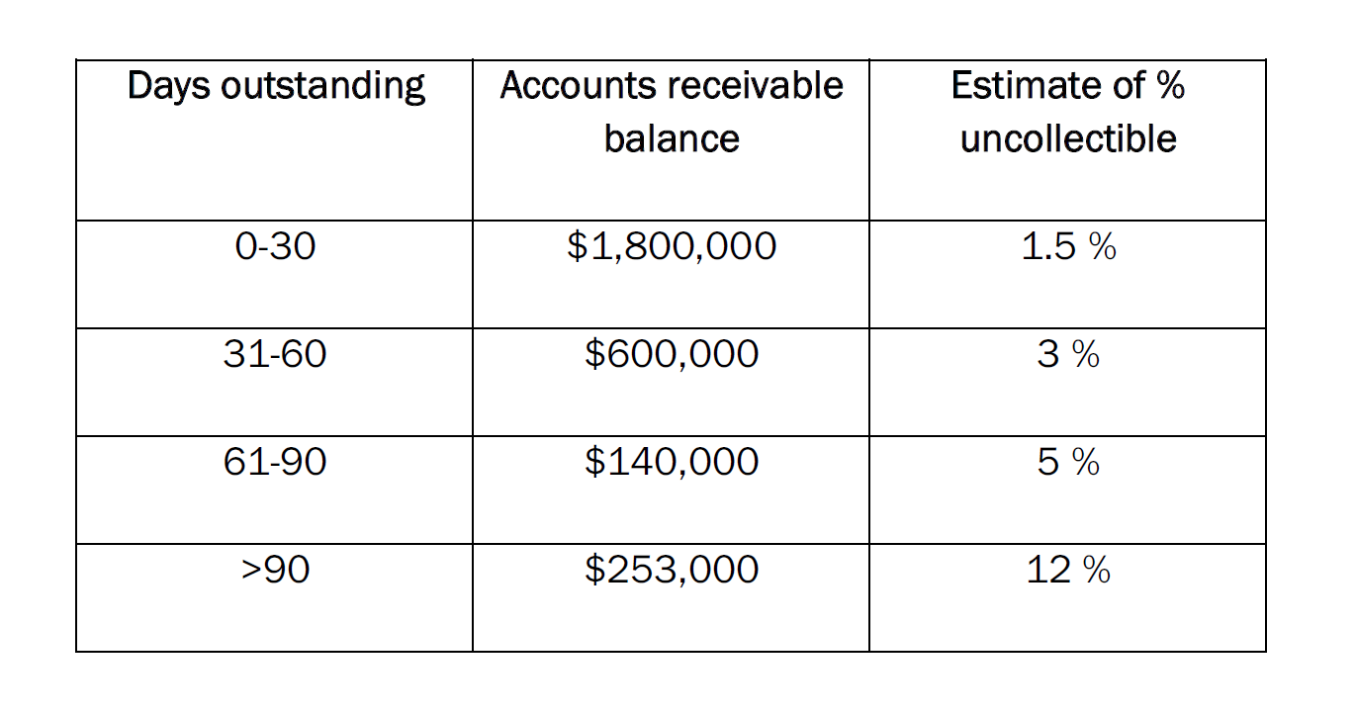
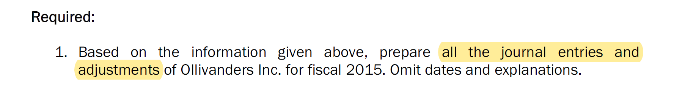

Slide 4
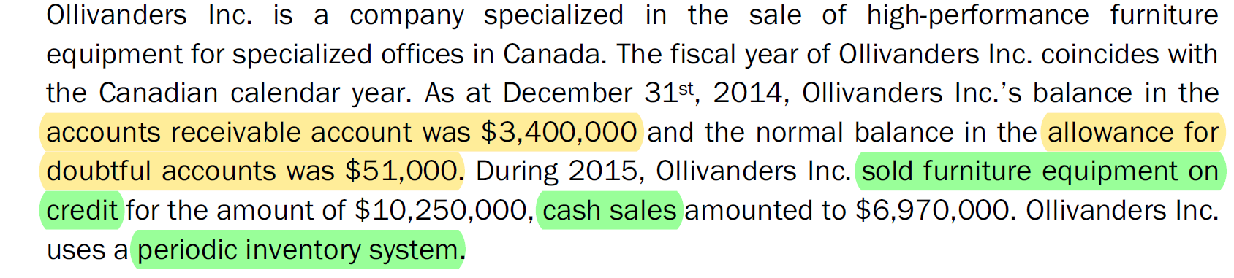
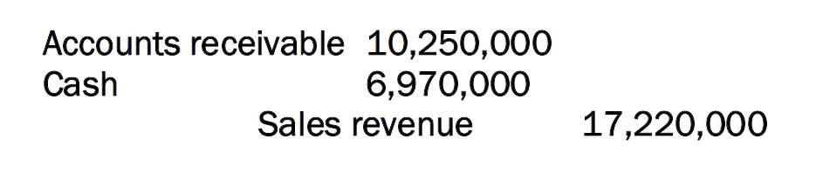
401120
401120
Accounts receivable
Allowance for doubtful accounts
3,400,000
51,000
10,250,000

Slide 5
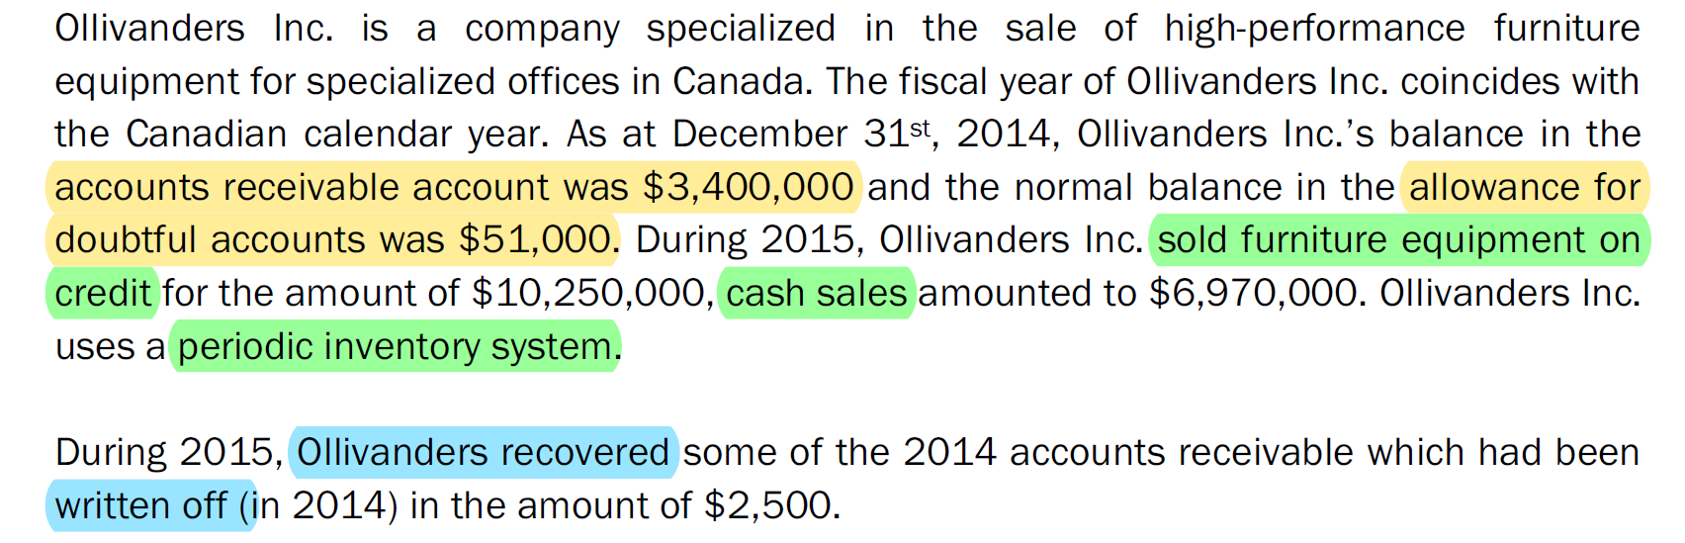
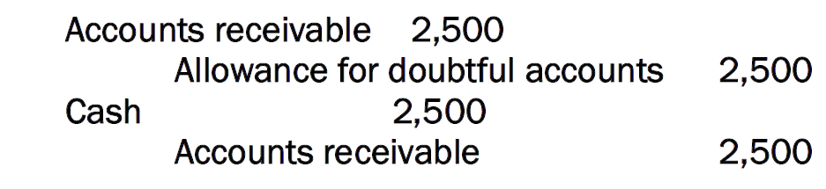
Accounts receivable
Allowance for doubtful accounts
3,400,000
2,500
51,000
10,250,000
2,500
2,500

Slide 6
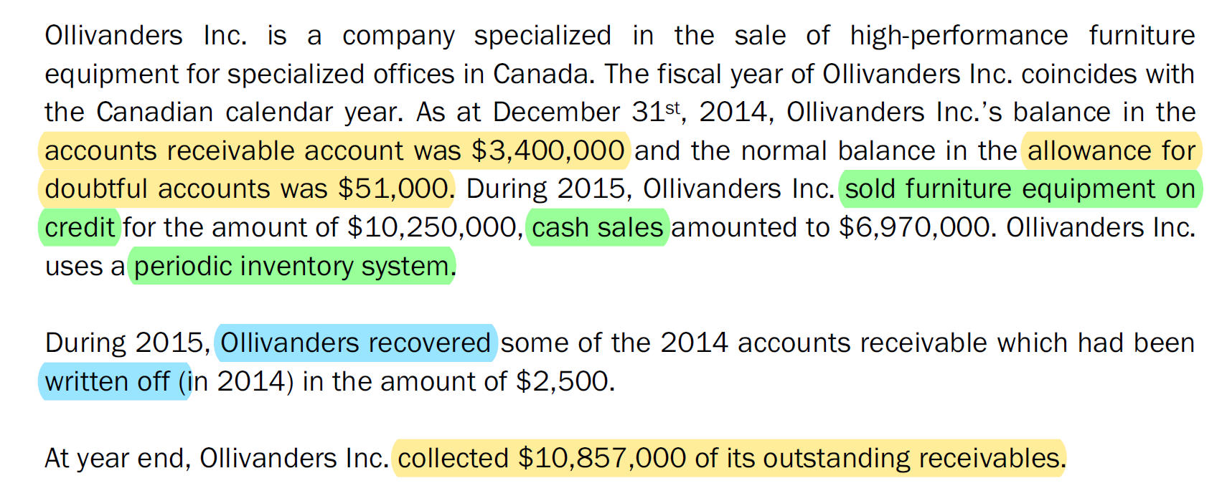
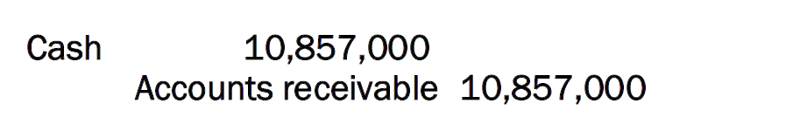
Accounts receivable
Allowance for doubtful accounts
3,400,000
2,500
51,000
10,250,000
10,857,000
2,500
2,500

Slide 7
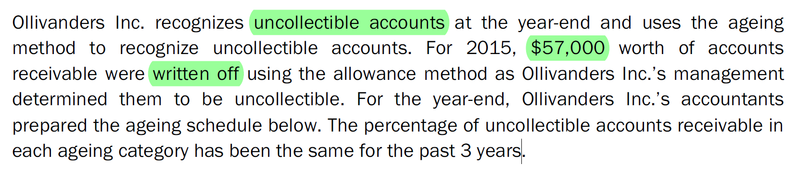
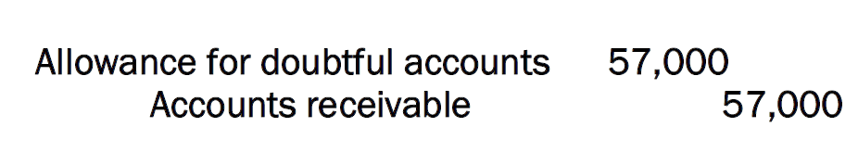
Accounts receivable
Allowance for doubtful accounts
3,400,000
2,500
57,000
51,000
10,250,000
10,857,000
2,500
2,500
57,000

Slide 8
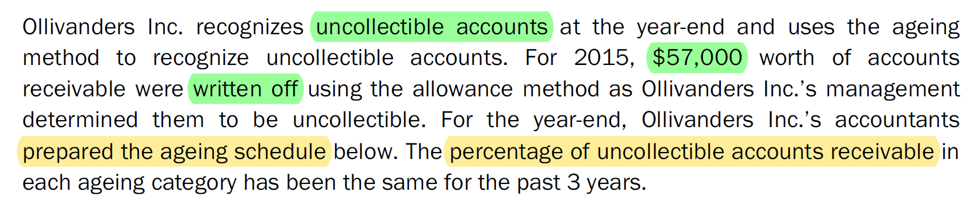
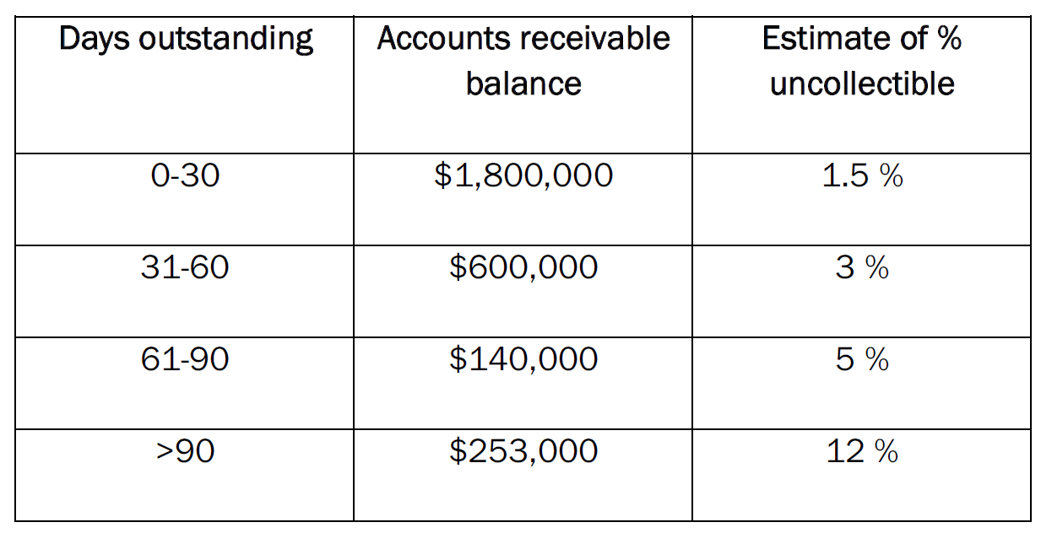
1,800,000 *1.5%=27,000
600,000 *3%=18,000
140,000 *5%=7,000
253,000 *12%=30,360
The value of allowance for doubtful accounts should be:
27,000 +18,000+ 7,000+ 30,360 = 82,360

Slide 9

The value of accounts for doubtful accounts should be: 82,360
Before adjustment
Accounts receivable
Allowance for doubtful accounts
3,400,000
2,500
57,000
51,000
10,250,000
10,857,000
2,500
2,500
57,000
3,500
2,736,000
After adjustment
Accounts receivable
Allowance for doubtful accounts
3,400,000
2,500
57,000
51,000
10,250,000
10,857,000
2,500
2,500
57,000
85,860
2,736,000
82,360

Slide 10
Receivables turnover ratio =
Net credit sales/Average gross accounts receivable during the year
the amount reported in the Accounts Receivable account (before deducting allowance for doubtful accounts)
This ratio is used to assess the liquidity of receivables. It measures the number of times, on average, that receivables are collected during the year.
Average gross accounts receivable= (3,400,000+2,736,000)/2=3,068,000
Receivable turnover ratio=
10,250,000/3,068,000=3.34
Accounts receivable
3,400,000
2,500
10,250,000
10,857,000
2,500
57,000
2,736,000

Slide 11
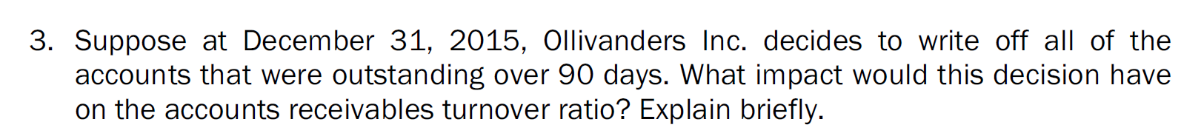
Receivables turnover ratio =
Net credit sales/Average gross accounts receivable during the year

Slide 12
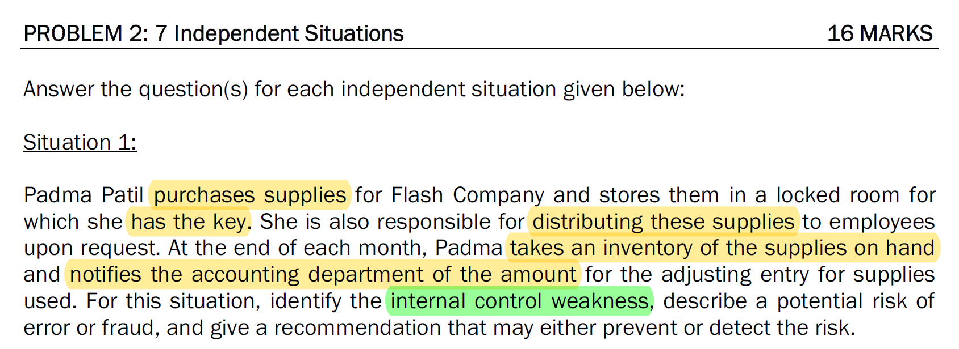
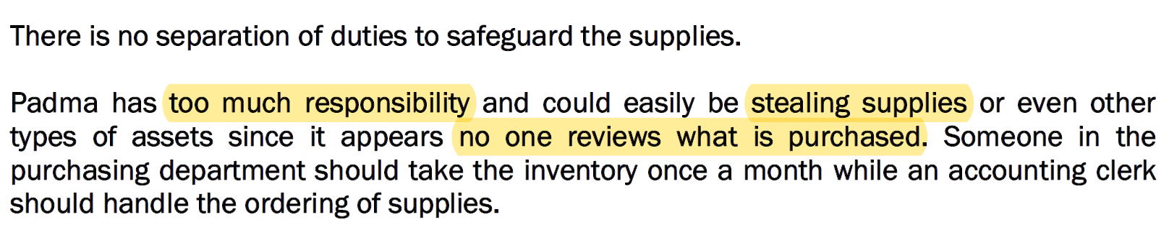

Slide 13
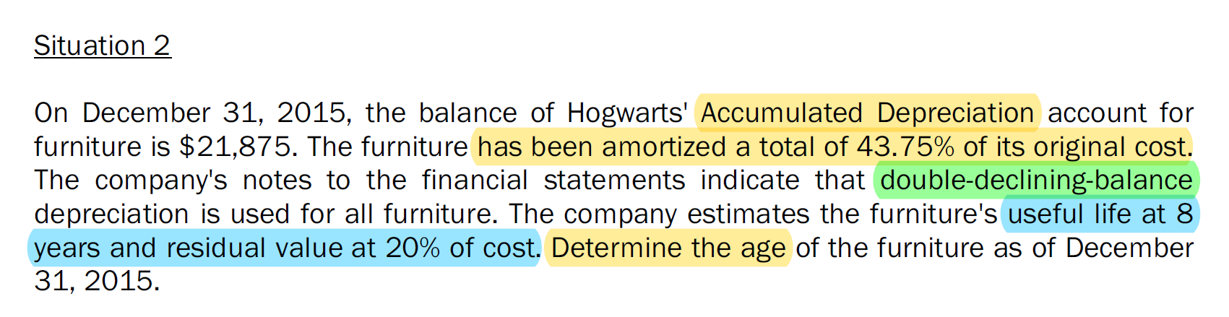
original cost : $21,875/0.4375 = $50,000
double-declining-balance depreciation rate: 1/8*2=0.25
first year's depreciation expense: $50,000 × 0.25 = $12,500
second year's depreciation expense: $37,500 × 0.25 = $9,375
balance in accumulated depreciation: $12,500 + $9,375 = $21,875
The Furniture is 2 years old

Slide 14
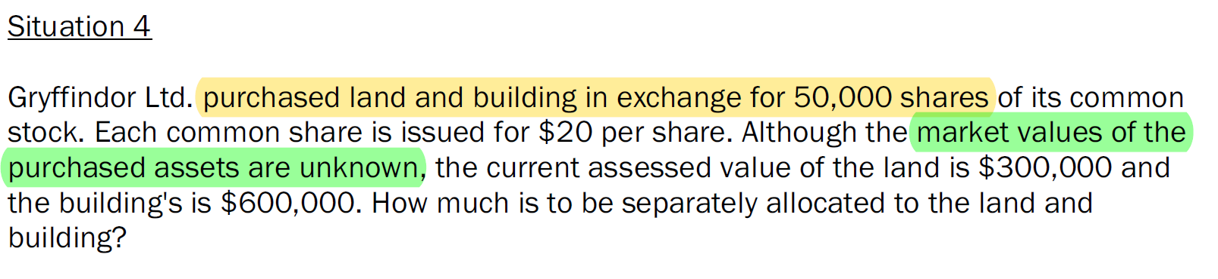
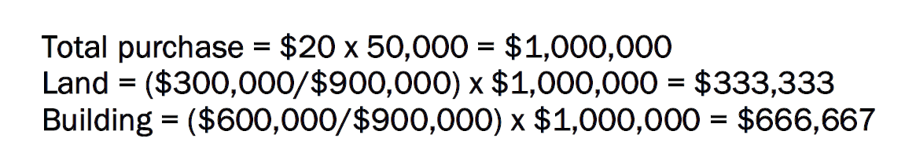
When shares are issued for a noncash consideration, they should be recorded at the fair value of the consideration received.
If the fair value of the consideration received cannot be reliably determined, then the fair value of the consideration given up would be used instead.

Slide 15
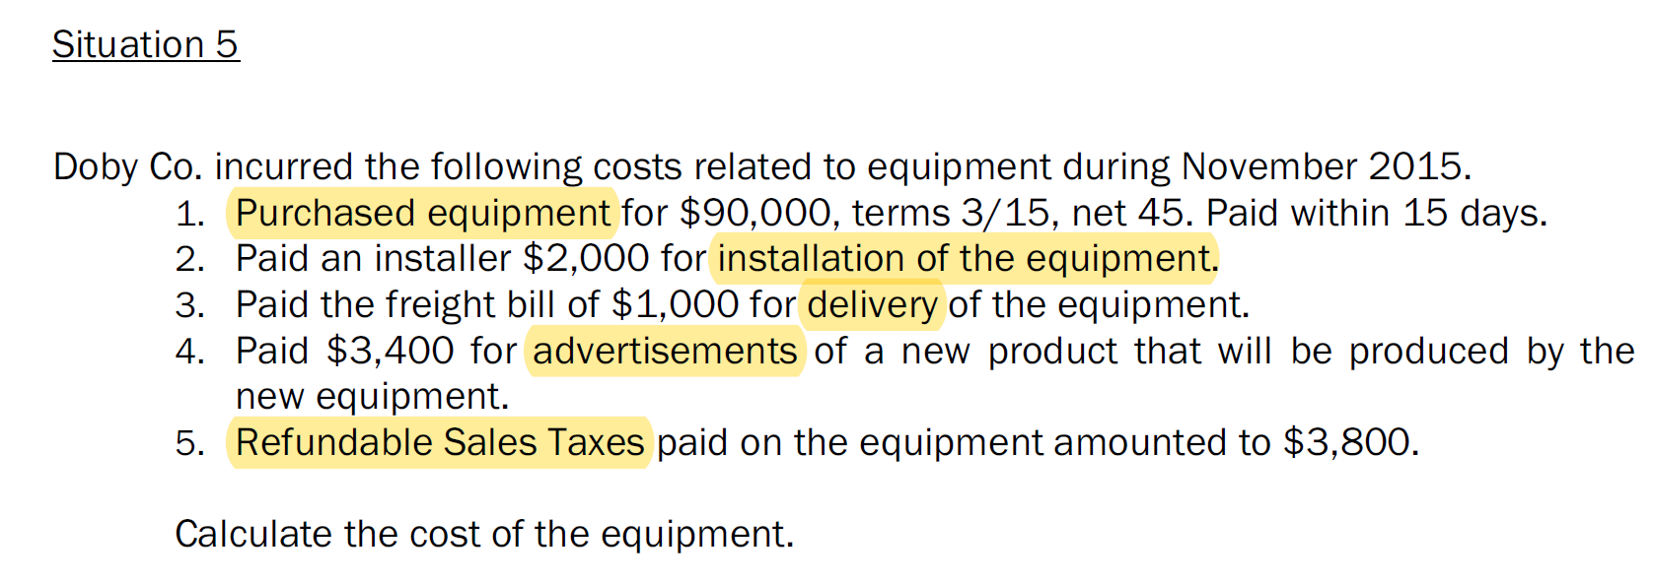
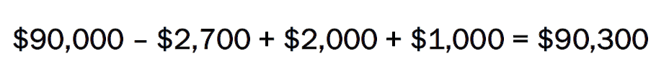

Slide 16
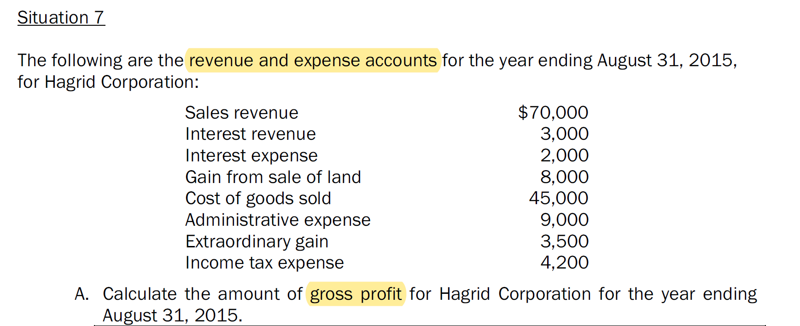

Slide 17
10 mins Break

Slide 18
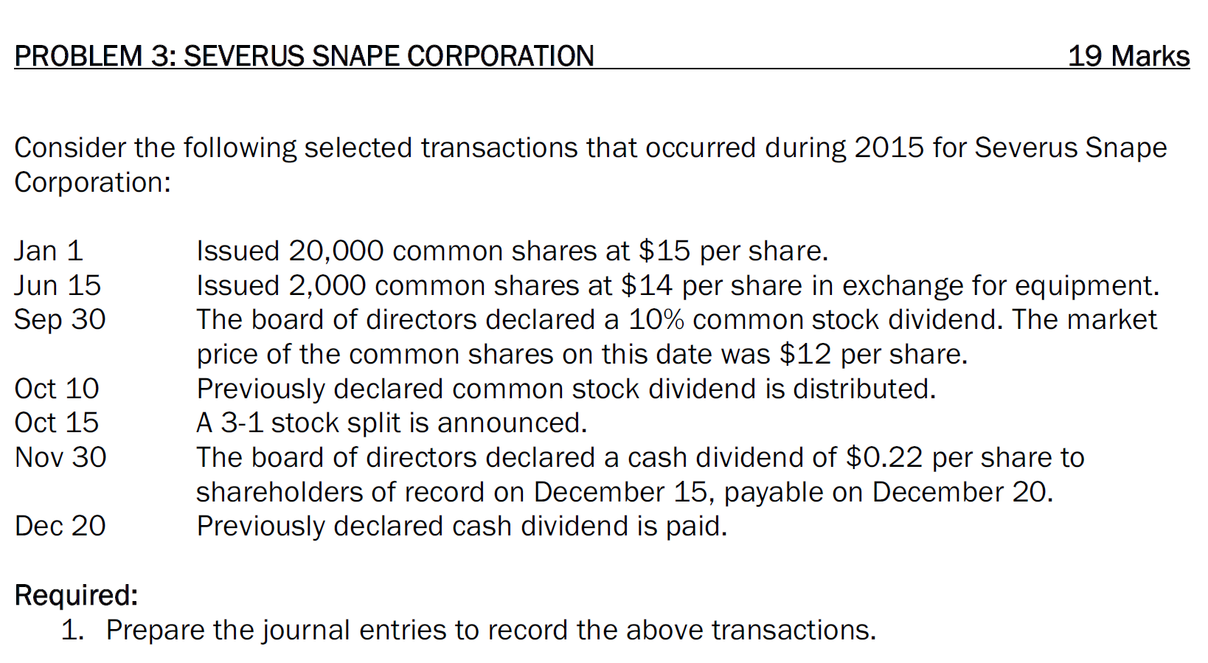

Slide 19
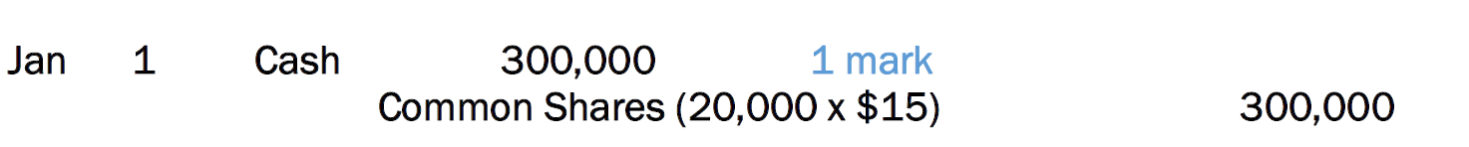

Slide 20
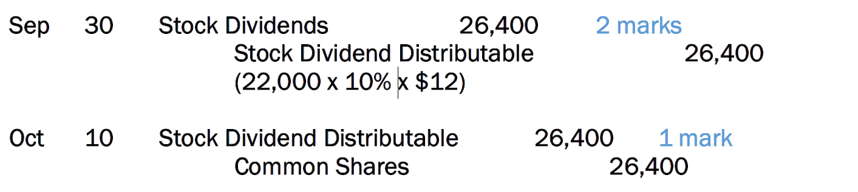

Slide 21

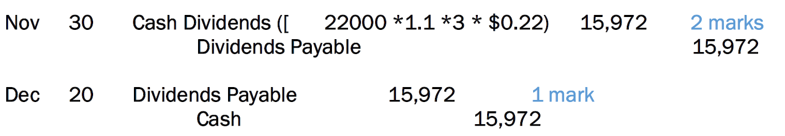

Slide 22
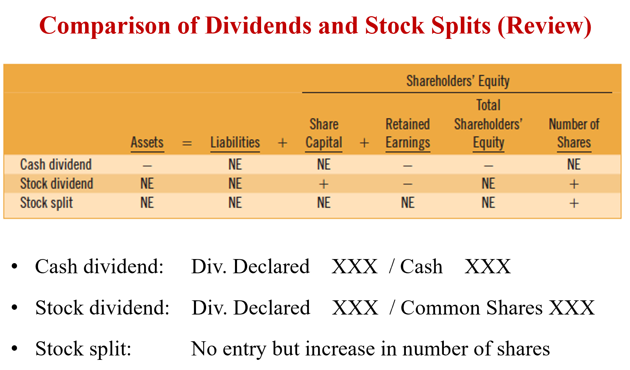
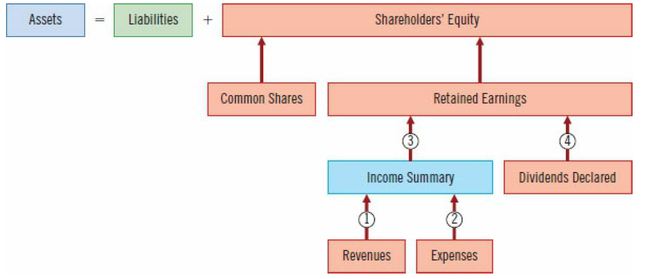

Slide 23
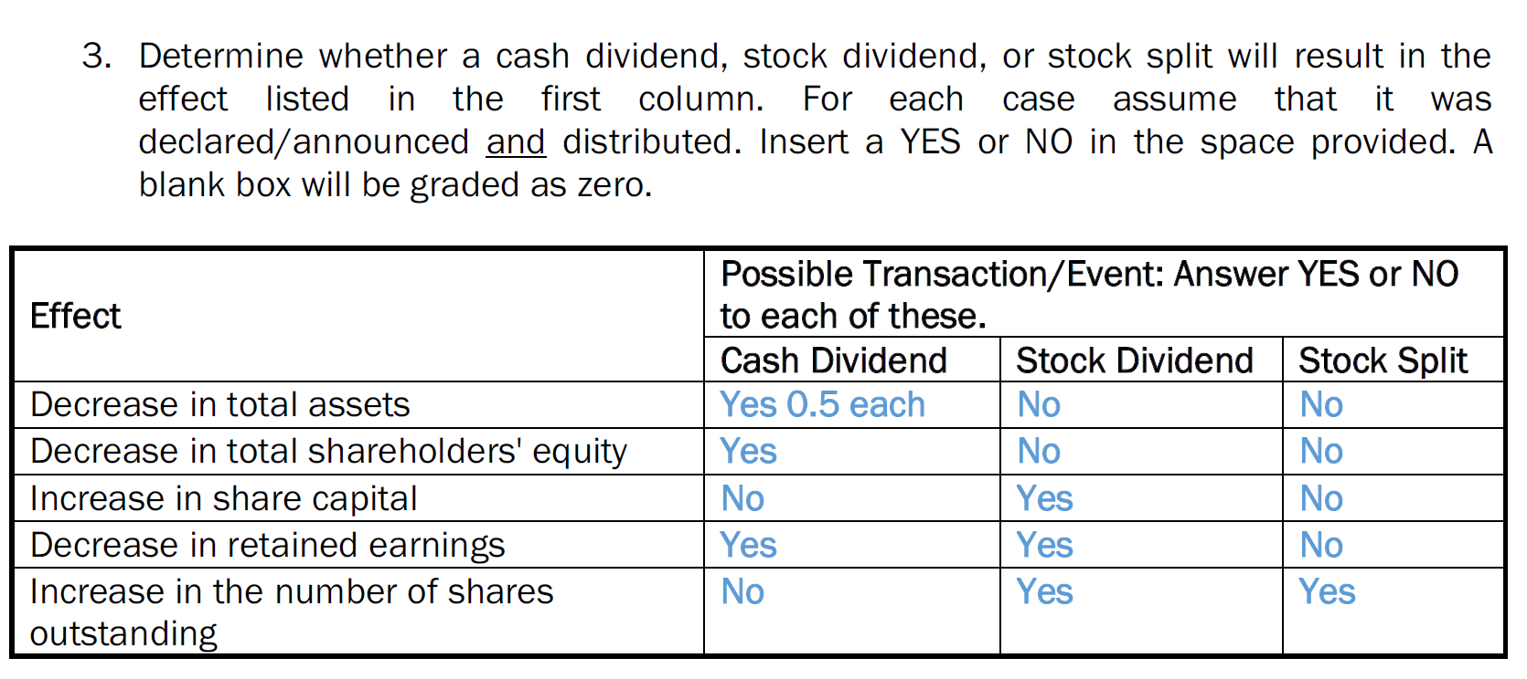

Slide 24
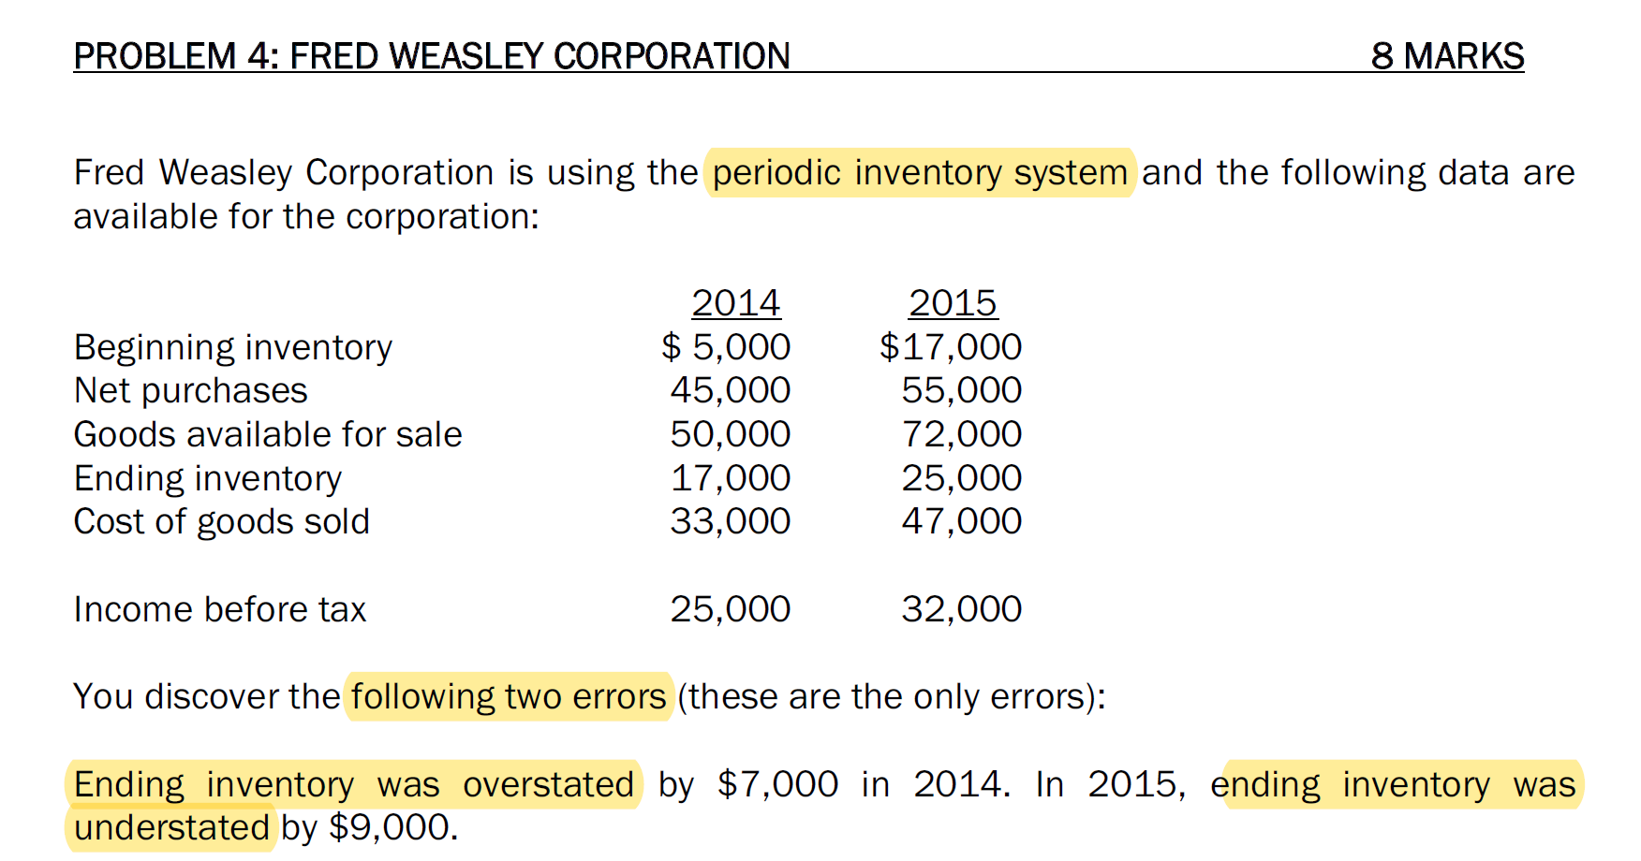

Slide 25
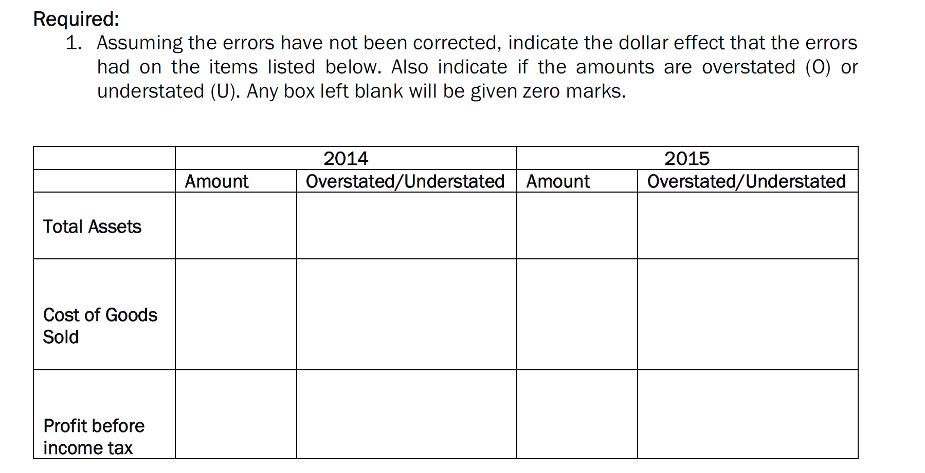

Slide 26
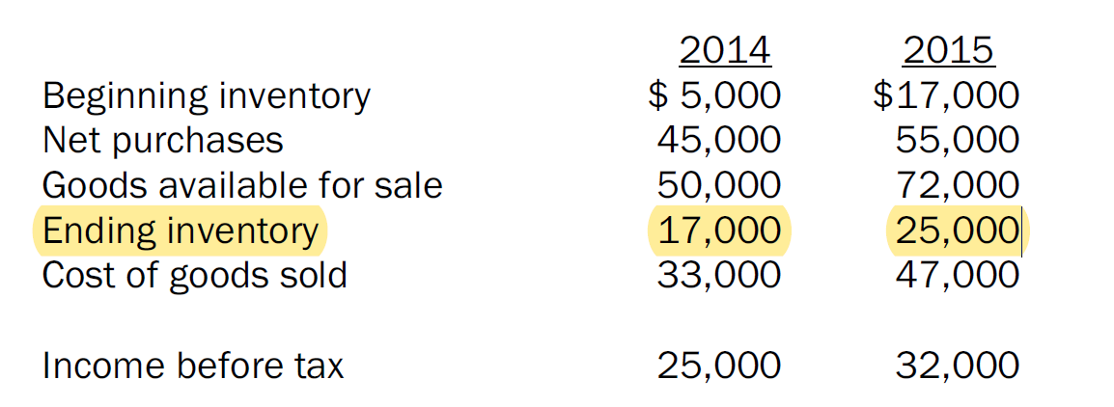
7000
7000
9000
Cost of goods sold = Cost of goods available for sale – Ending inventory
= Beginning inventory + Net purchases – Ending inventory
2014
7,000
7,000
2015
16,000
7,000
9,000

Slide 27
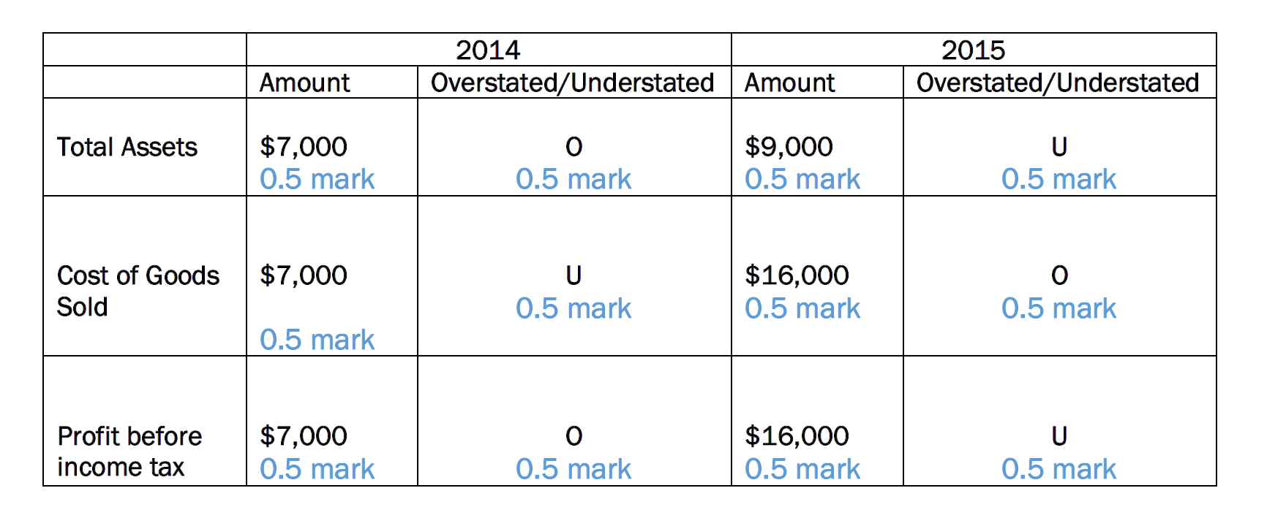

Slide 28
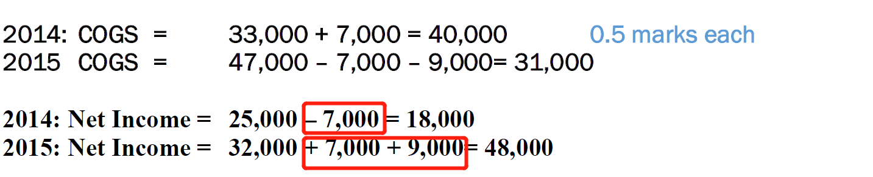
2014 income before tax= 25,000 -7,000 = 18,000
2015 income before tax = 32,000 + 7,000 + 9,000= 48,000

Slide 29
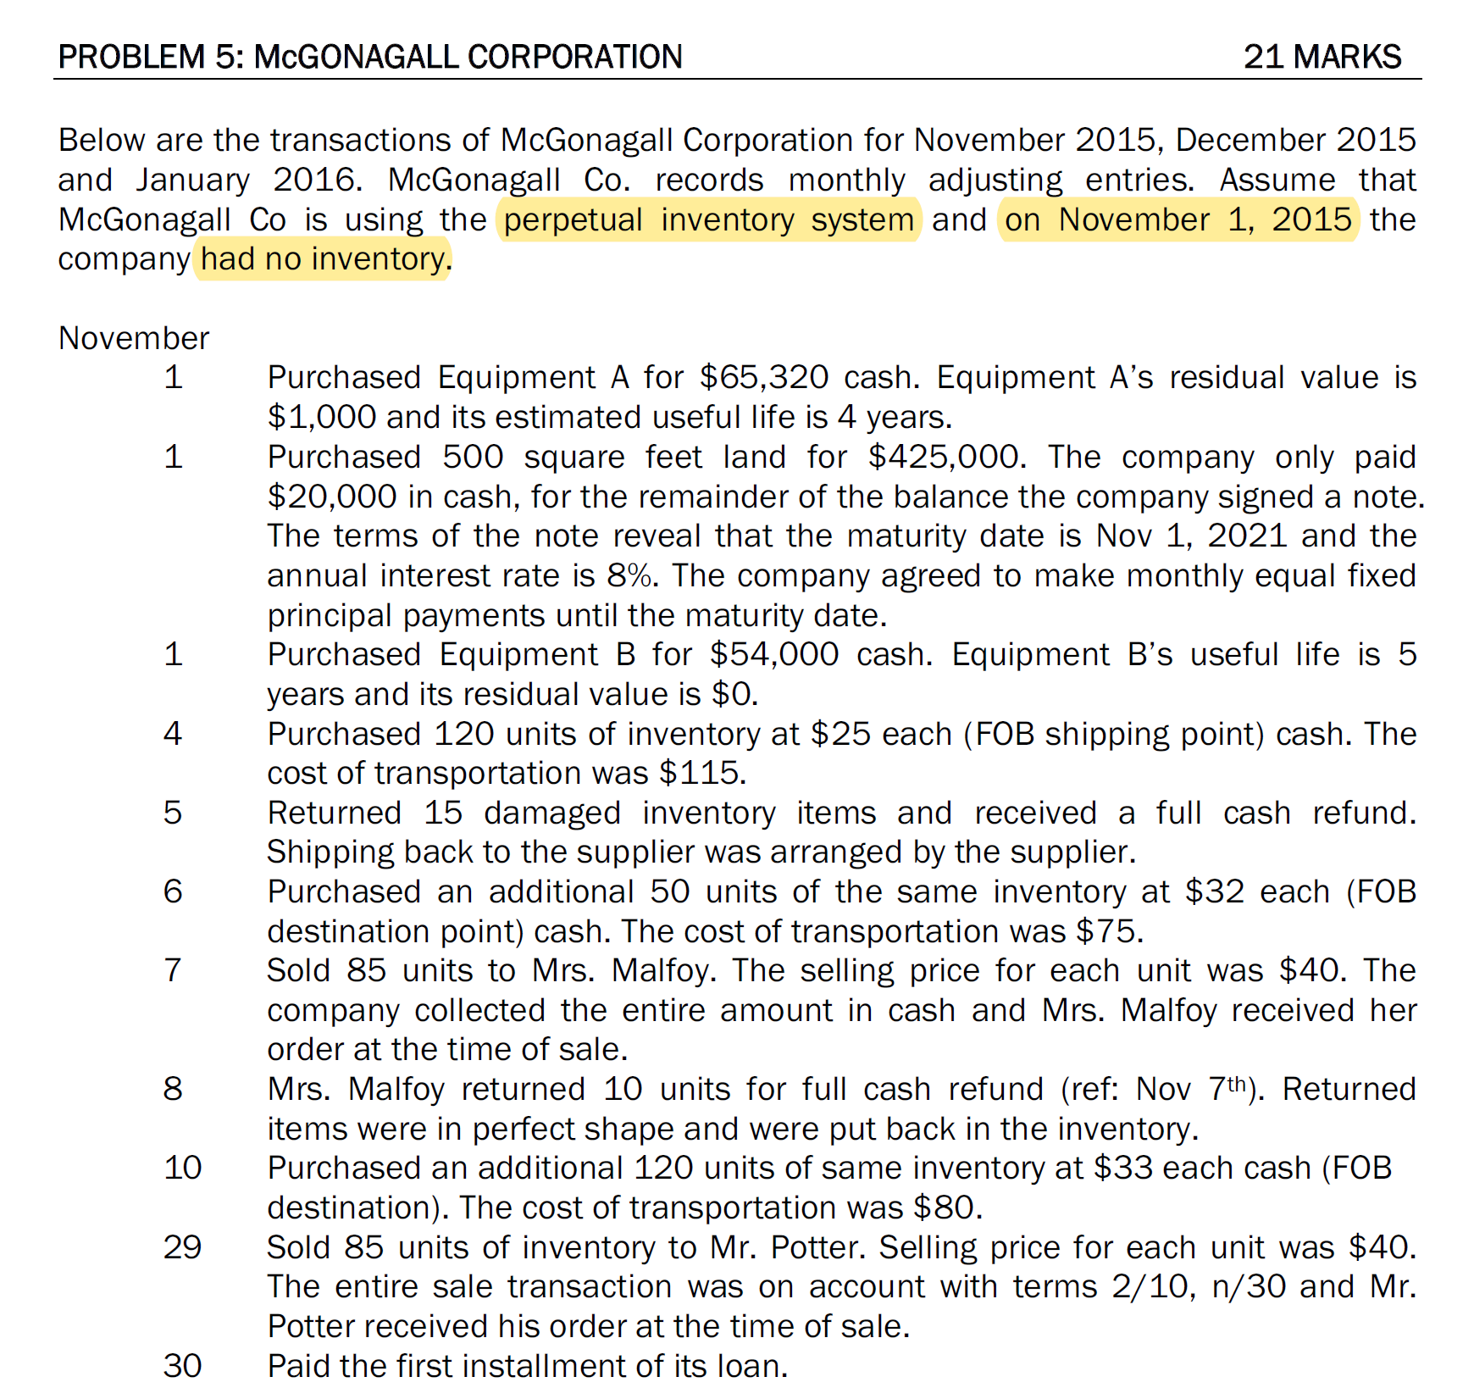

Slide 30
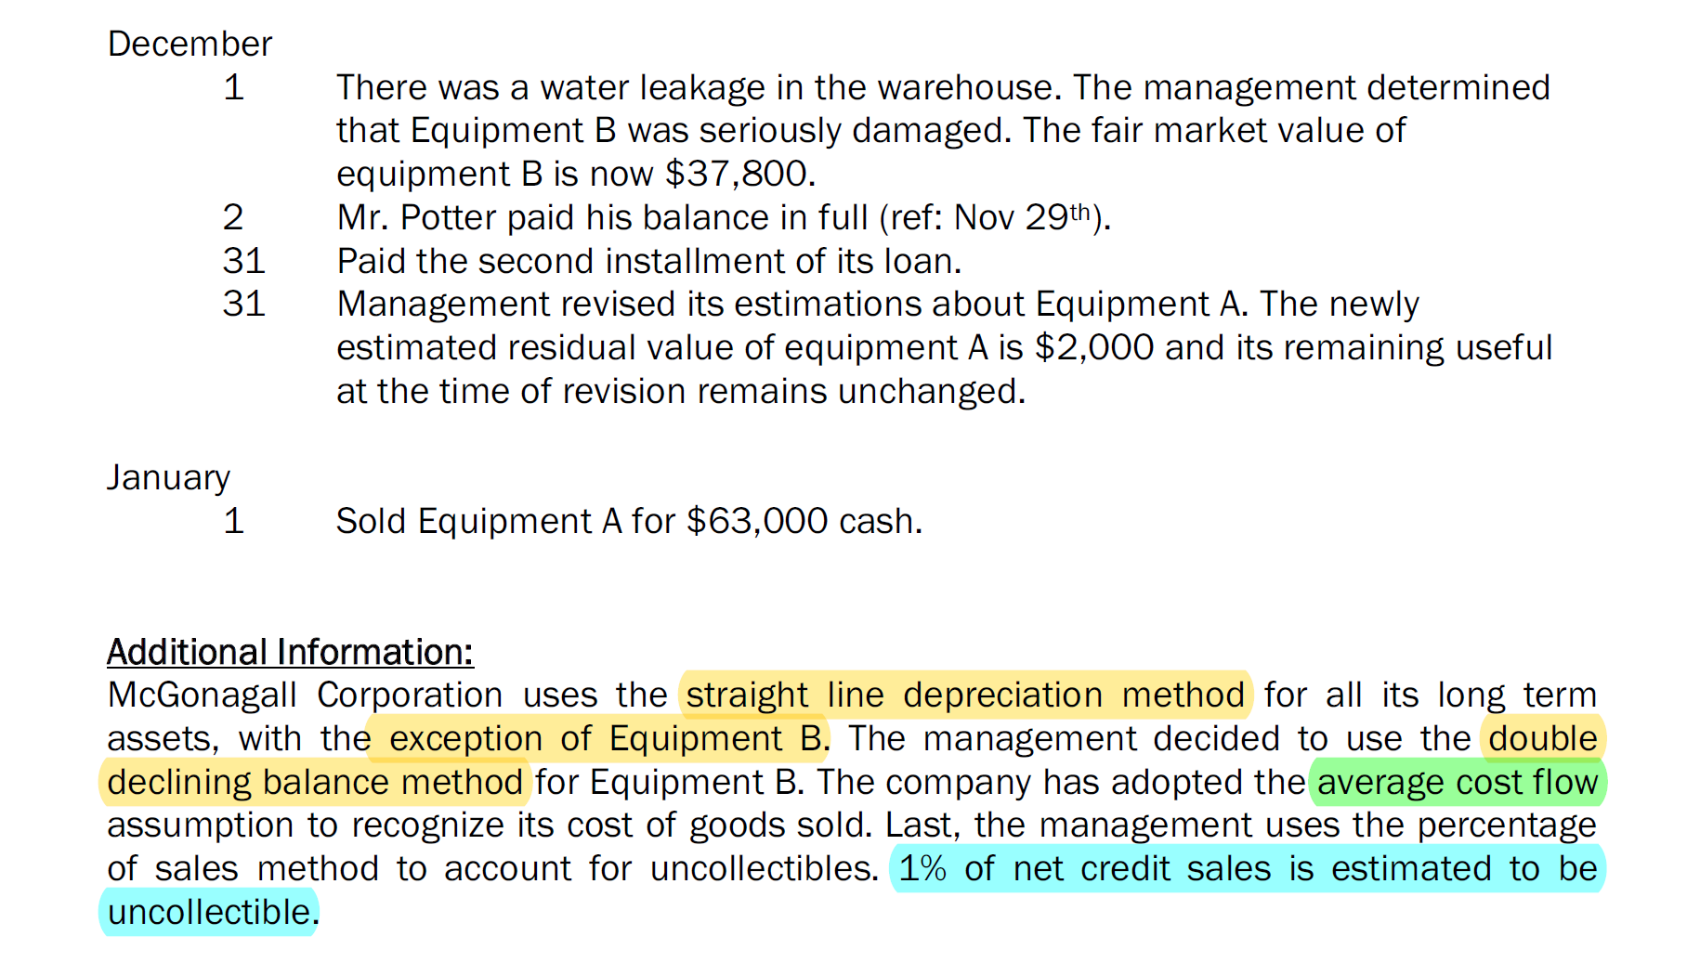

Slide 31
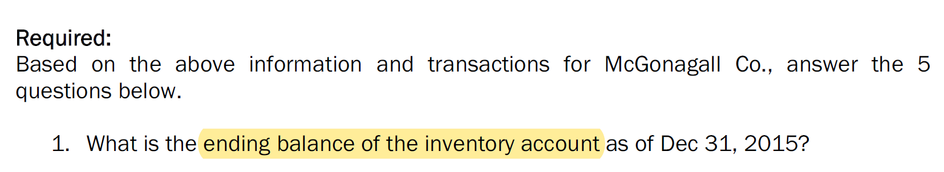
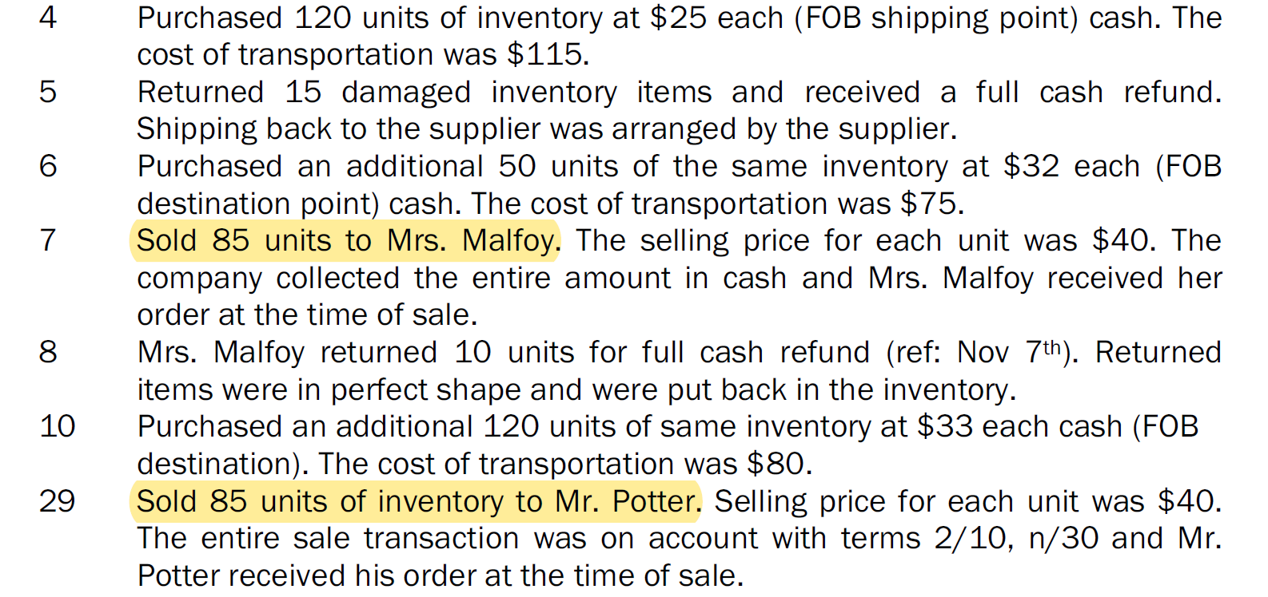
Average cost method

Slide 32
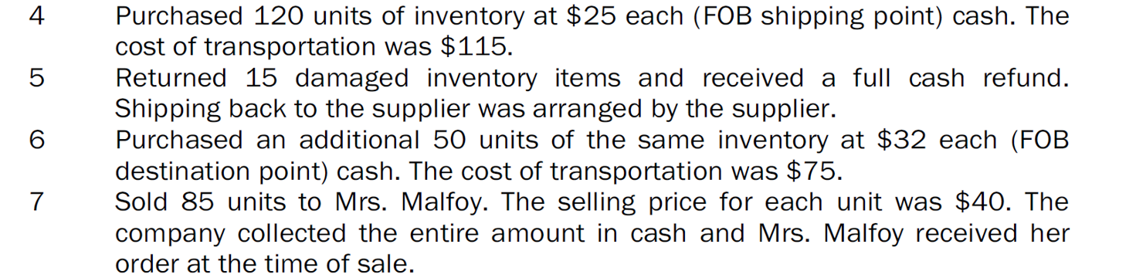
Nov 7:
Total value of inventory before sale:
105*25 + 115 + 50*32 = 4,340
Total number of inventory before sale:
105 + 50 = 155
Unit cost for sale:
4,340/155 = 28
GOGS: 85*28 = 2380
Inventory balance: 70*28= 1960
50 unit × $32
70 unit × $28
105 unit × $25
$115

Slide 33
80 unit × $28
70 unit × $28
after
return
Inventory balance: 80*28 = 2240
Number of inventory: 80 units

Slide 34
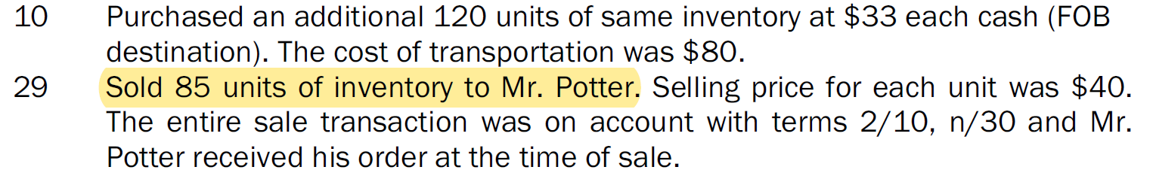
Nov 29:
Total value of inventory before sale:
80*28 + 120*33 = 6200
Total number of inventory before sale:
80 + 120 = 200
Unit cost for sale:
6200/200 = 31
GOGS: 85*31 = 2635
Inventory balance: 115*31= 3565
120 unit × $33
115 unit × $31
80 unit × $28

Slide 35
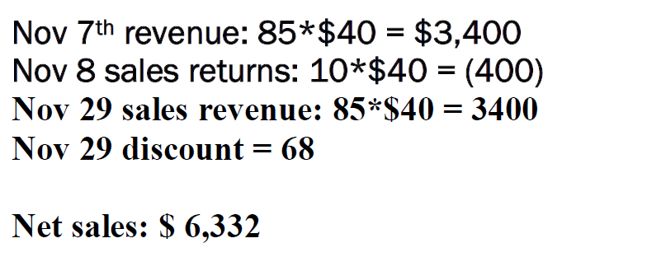
(3400*0.02)

Slide 36
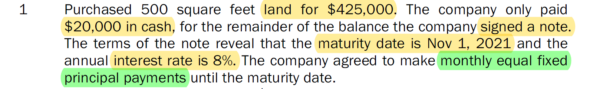
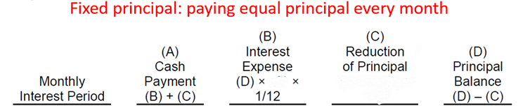
8%
405,000/(6*12)
Issue date
425,000-20,000=405,000
Nov 31
$8,325
$2,700
$5,625
$399,375
Dec 31
$8,288
$2,663
$5,625
$393,750
Interest expense 2700
Loan payable 5625
Cash 8325

Slide 37
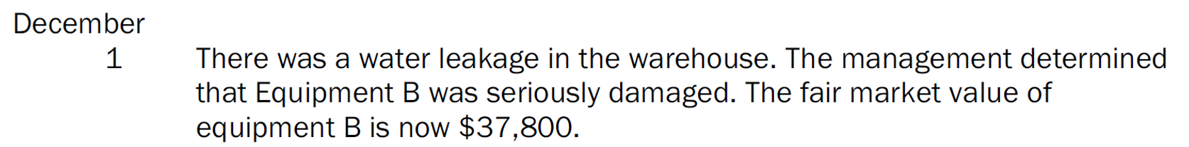
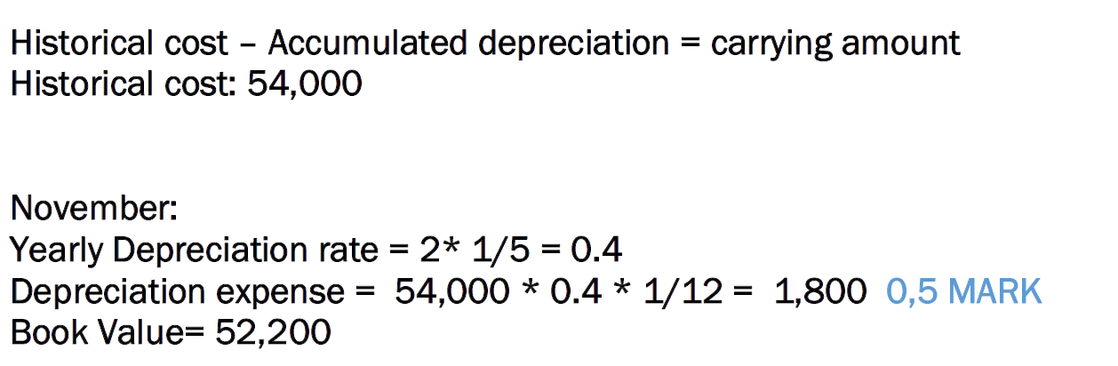
double declining balance method
(54000-1800)

Slide 38
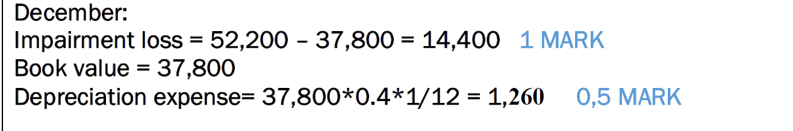
double declining balance method
Book value at the end of Dec: 37,800 – 1,260 = 36,540

Slide 39

double declining balance method
Book value at the end of Jan: 36,540 – 1,218 = 35,322

Slide 40
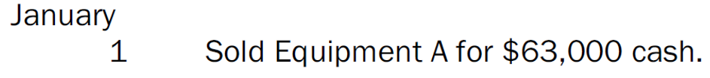
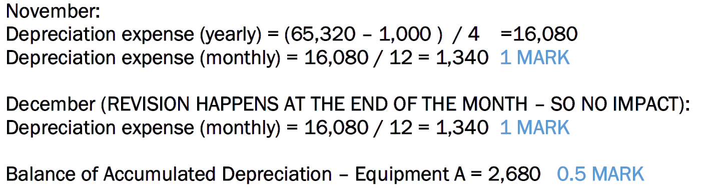
December
Carrying amount of Equipment A = 65,320 -2,680 = 62,640
Gain on disposal: 63,000 – 62,640 = 360

Slide 41
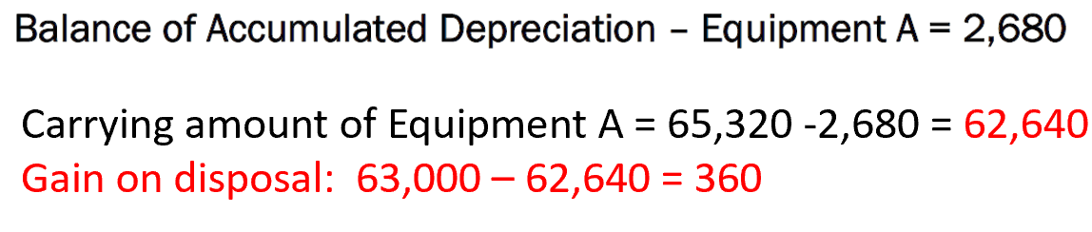
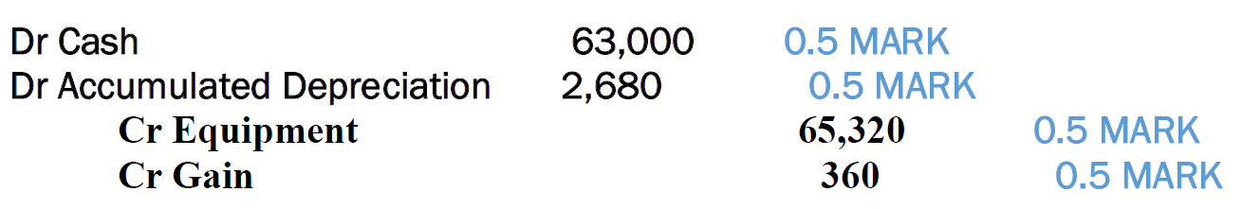
December

Slide 42
10 mins Break

Slide 43


Accounts receivable at ending = accounts receivable at beginning + credit sales - Cash received from customers for paying accounts receivables
Cash received from customers for paying accounts receivables
= accounts receivable at beginning + credit sales - accounts receivable at ending
= 8,200 + 200,000 – 9,900 = 198,300
Cash received from customers = Cash received from customers for paying accounts receivables + Cash sales
= 198,300 + 19,500 = 217,800

Slide 44


Inventory ending = inventory beginning + inventory purchase – COGS
Inventory purchase = Inventory ending – inventory beginning + COGS
= 5,400 – 2,500 + 71,000 = 73,900
Accounts payable to suppliers beginning + inventory purchase – cash paid to suppliers = accounts payable to suppliers ending
Cash paid to suppliers = Accounts payable to suppliers beginning + inventory purchase - accounts payable to suppliers ending = 3,800 + 73,900 – 3,100 = 74,600

Slide 45


Accrued salaries payable ending = Accrued salaries payable beginning + salaries expense reported – cash salaries paid to employees
cash salaries paid to employees = Accrued salaries payable beginning + salaries expense reported - Accrued salaries payable ending = 1,750 + 40,000 – 1,800 = 39,950
Accrued vacation pay payable ending = Accrued vacation pay payable beginning + vacation pay expense reported – cash vacation pay paid to employees
cash vacation pay salaries paid to employees = Accrued vacation pay payable beginning + vacation pay expense reported - Accrued vacation pay payable ending = 0 + 2,600 – 800 = 1,800
Cash paid to employees = cash salaries paid to employees + cash vacation pay salaries paid to employees = 39,950 + 1,800 =41,750

Slide 46


Slide 47


14 = 2,081,947/((150,000+B)/2)
B=147,421

Slide 48


cost of goods sold = net sales – gross profit = 2,081,947 - 2,081,947*0.4 = 1,249,168.2
12.62 times =
1,249,168.2 /( (138,000+C)/2 )
C= 59,966.4

Slide 49

Current ratio = current assets/ current liabilities
3 = D/110,763
D = 332,289

Slide 50

B=147,421
C= 59,966.4
D = 332,289
A = D – B – C – 8,902 – 10,195 = 105,804.6
= 314,106 – 110,763 = 203,343

